Slide 1
Welcome to The Data Mine!
Week 1 Lab Session

Slide 2
Week 1 Lab Schedule
Introductions, project/company information and logistics (15 mins)
Lego Agile activity instructions and set up (10 minutes)
Lego Agile activity (1 hour)
Presentation of final product (10 minutes)
Tear down and clean up (15 minutes)

Slide 3
Introductions and project information

Slide 4
Agile crash course

Slide 5
What is Agile?
Customer is actively involved in planning and prioritizing work and provides frequent feedback
Agile is a method of customer-focused project management focused on incremental and iterative delivery
How teams complete work
Instead of just delivering a final product all at once there is a regular cadence of feature delivery

Slide 6






Roles in Agile
Product owner:
Represents the customer
Develops and prioritizes user stories (features the customer wants in the product)
Accepts and rejects work
Scrum Master:
Organizes work on the development team
Ensures communication between roles
Removes bureaucratic barriers
Developers:
Responsible for delivering features
Work cross-functionally with other members of the development team

Slide 7
Sprint Cycles
Sprint Planning
Work with PO to determine work to be accomplished during the upcoming sprint
Sprint
Work time to deliver on the features identified during planning
Sprint Review
Present work accomplished during the sprint to the PO and get feedback
Retrospective
Review backlog
Review how the sprint went and how things can be improved in the future
* All Data Mine Corporate Partner projects will utilize an Agile framework this year; grades will be primarily based on your performance during sprints

Slide 8
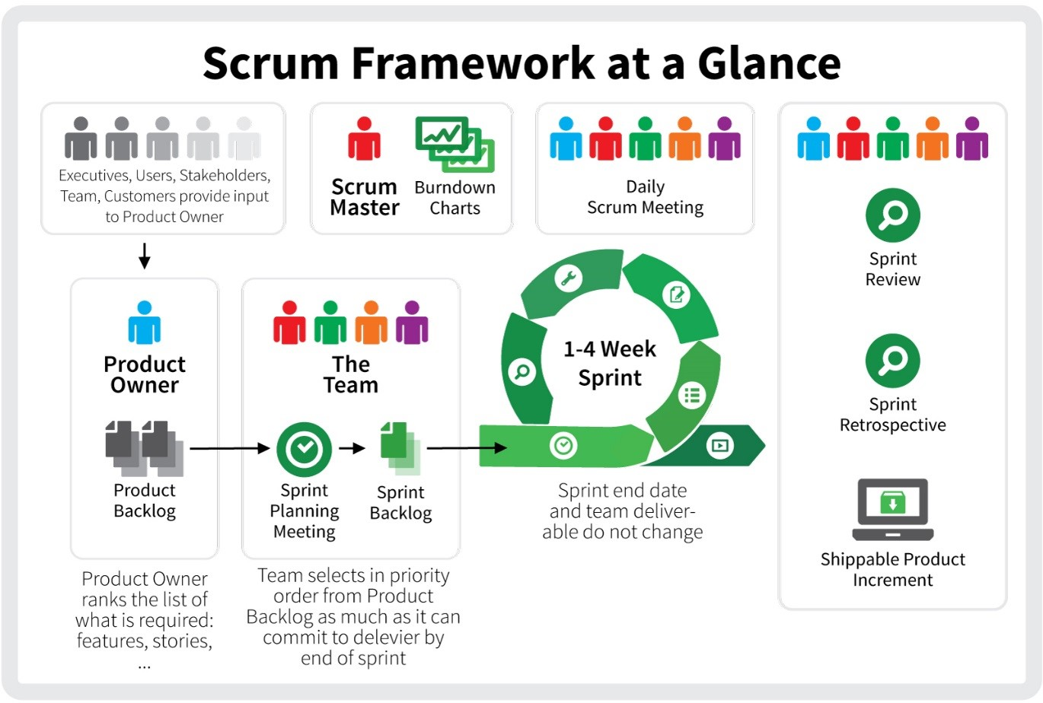
Agile Basics

Slide 9
Lego agile activity

Slide 10
Task: Design and build a new building for The Data Mine

Slide 11
Instructions
Teams
Unless otherwise instructed, split your team evenly into 2 groups
There should be 3-9 people per group
Each sub team should have a Lego set and project board.
Roles
A Data Mine staff member or your TA will act as the product owner for this activity.
All team members will act as developers.

Slide 12
Sprint Timeline
Sprint Planning (4 minutes)
Choosing what tasks to do during the sprint, estimating time/distributing work, and working with the product owner to clarify tasks.
Use sticky notes to add your initials to the card(s) you will own for the current sprint
Sprint (8 minutes)
Work time in which the product owner is not actively working with you.
Sprint Review (3 minutes)
Present work from the sprint to the product owner and get feedback.
Retrospective (2 minutes)
Discuss what went right, what went wrong, and how you can fix issues in the next sprint (e.g., how you collaborate, estimating time required for tasks, etc.)
Repeat! (3x)

Slide 13
Instructions
Product owners have developed a backlog of tasks. Your sub team will be responsible for allocating work in an Agile methodology and executing the tasks.
However, there are a few caveats…
Your team will need to identify and deliver the minimum viable product (MVP)
You will need to work with the product owner to clarify requests tasks in the backlog.
You may not be able to complete all of the tasks on the backlog with the time and materials provided (you will need to negotiate with the PO!).
Remember, product owners can also change their minds – you may need to be flexible if you build something and they don’t like it.
Creativity is encouraged! A Lego can represent anything as long as it is explained (and communication is a key part of Agile!)

